Slide 1
50.003: Elements of Software Construction
Week 5
Software Testing
(with some slides from Darko Marinov and Andreas Zeller)

Slide 2
Why bother testing?

Slide 3
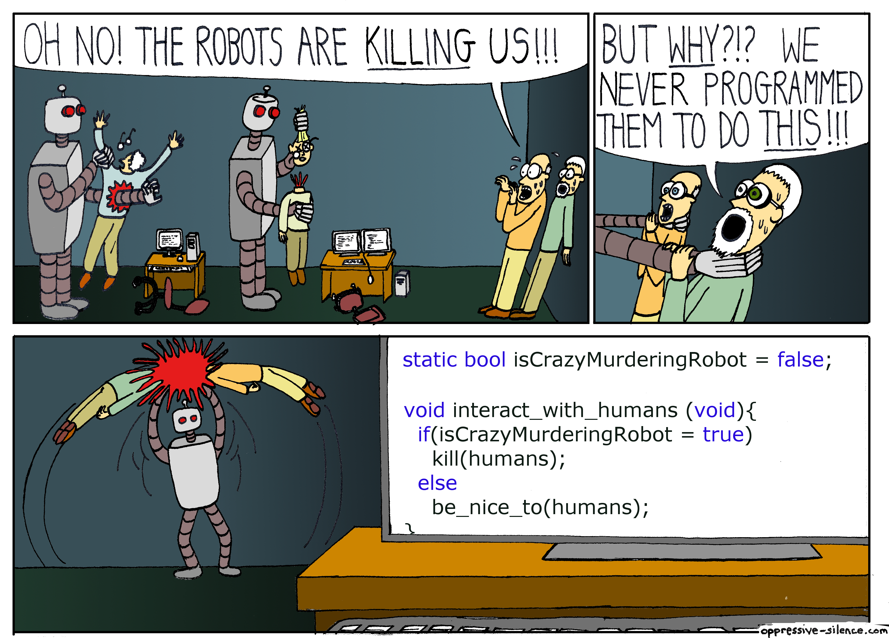
Picture from http://oppressive-silence.com/comic/oh-no-the-robots

Slide 4

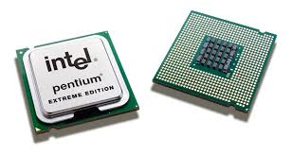
Back in school did you get “0” for not providing
units to number?
7 week?
7 month?
7 years?
Different engineers used different units
Mars Climate Orbiter
327.6 million USD lost (1998)
Missed five (5) entries while copying a lookup
table having 1066 entries
Pentium Floating point debacle
475 million USD lost (1995)

Slide 5
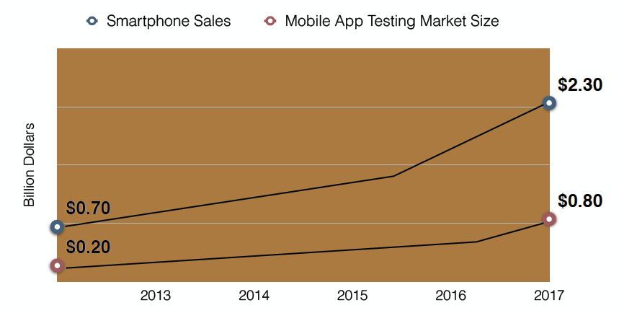
Testing Market

Slide 6
Testing Effort
Reported to be >50% of development cost [e.g., Beizer 1990]
Microsoft: 75% time spent testing
50% testers who spend all time testing
50% developers who spend half time testing

Slide 7
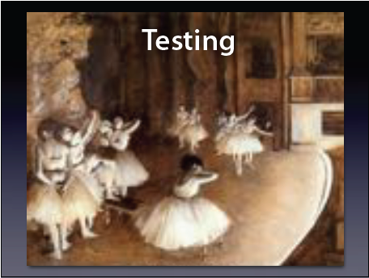
Testing is like Rehearsal?
Edgar Degas: The Rehearsal. With a rehearsal, we want to check whether everything will work as expected.
This is a test

Slide 8
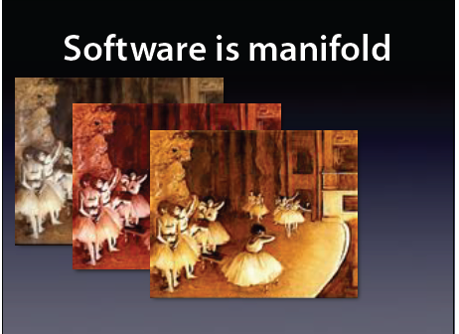
But?
Software is not a planned linear show. Meaning, if it works once, will it work again?

Slide 9
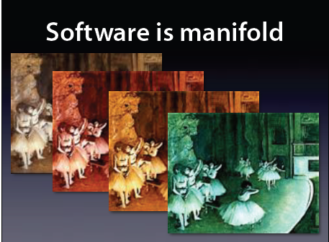
But?
Software has multitudes of possibilities.

Slide 10
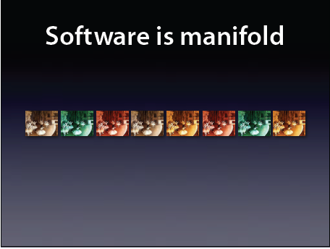
But?
Software has multitudes of possibilities and it keeps growing.

Slide 11
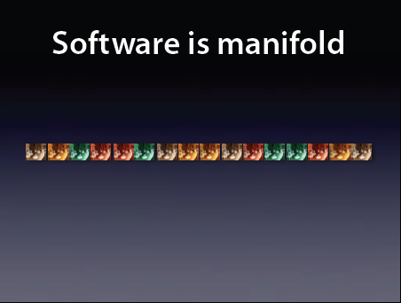
But?
And more…..

Slide 12
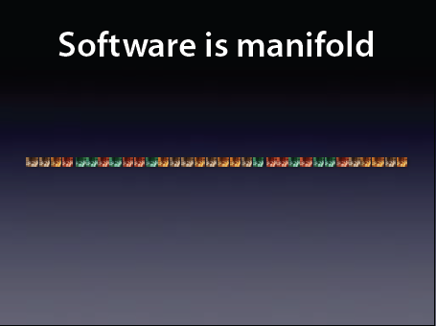
But?
And soon becomes unmanageable…..

Slide 13

A curse!!!
Testing can only find the presence of errors,
not their absence
Edsger W. Dijkstra
Computer Scientist
ACM Turing Award Winner, 1972
To show the absence of bugs: Static analysis, theorem proving, verification

Slide 14

Another curse!!!
Verification can only find the absence of errors,
not their presence (in general)
Andreas Zeller
Computer Scientist
ACM Fellow, 2010
To show the presence of bugs: Use testing

Slide 15
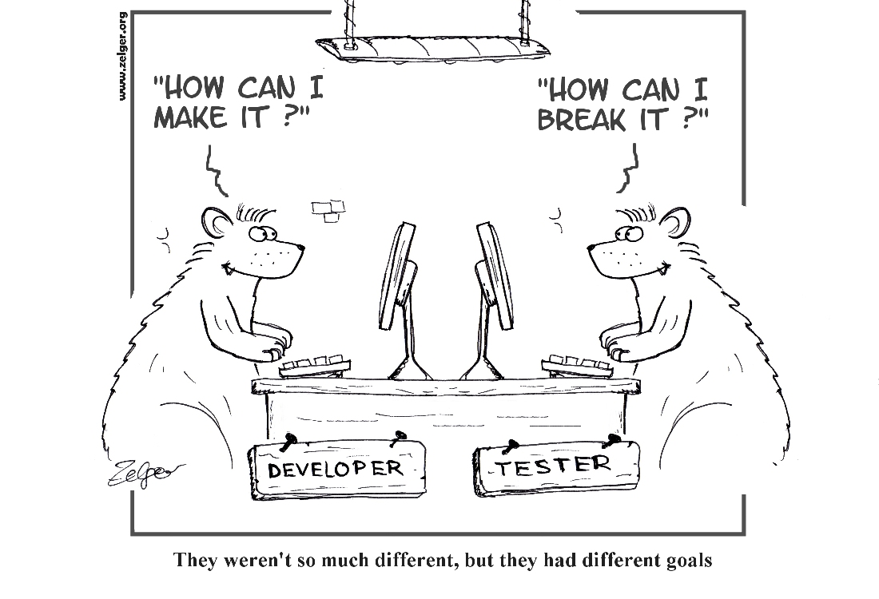
Testing is Industry Practice
We will take
the side of
this bear in this week

Slide 16
Basics of Testing and JUnit

Slide 17
What is a test?
Pass
Test
Oracle
Input
Program
Fail

Slide 18
JUnit
Open source Java testing framework used to write and run repeatable automated tests
A structure for writing test drivers
JUnit is widely used in industry
Account.java; AccountTest.java

Slide 19
Exercise 1
Given FindMax.java, write three test cases: one resulting in Failure, one resulting in Error and one resulting in Pass.
FindMax.java; FindMaxTest.java

Slide 20
Writing Tests for JUnit
Need to use the methods of the junit.framework.assert class
javadoc gives a complete description of its capabilities
Each test method checks a condition (assertion) and reports to the test runner whether the test failed or succeeded
assertTrue (boolean)
assertTrue (String, boolean)
assertEquals (Object, Object)
assertNull (Object)
Fail (String) //fail a test with (possibly) a given message
All of the methods return void
Notes:
Why do we need fail() method?

Slide 21
JUnit Test Fixtures
Different tests can use the objects without sharing the state
Objects used in test fixtures should be declared as instance variables
They should be initialized in a @Before method
JUnit runs them before every @Test method
Can be deallocated or reset in an @After method
JUnit runs them after every @Test method
Stack.java; StackTest.java

Slide 22
Exercise 2
Given the testRepOk method in StackTest.java, decompose it into multiple equivalent test cases.
StackTest.java; StackTestSolution.java

Slide 23
Parameterized Tests
How to test a function with similar values?
Parameterized Unit Tests Call Constructor For Each Logical Set of Data Values
Same Tests Are Then Run On Each Set of Data Values
List of Data Values Identified with @Parameters Annotation
ParameterizedTest.java

Slide 24
Exercise 3
Write a parameterized test for QuickSort.java.
QuickSortParameterizedTest.java

Slide 25
JUnit Tests
JUnit can be used to test …
… an entire object
… part of an object – a method or some interacting methods
… interaction between several objects
Each test is embedded into one test method
A test class contains one or more test methods
Test classes include :
A test runner to run the tests (main())
A collection of test methods
Methods to set up the state before and update the state after each test and before and after all tests

Slide 26
JUnit Resources
Some JUnit tutorials
http://open.ncsu.edu/se/tutorials/junit/
(Laurie Williams, Dright Ho, and Sarah Smith)
https://www.tutorialspoint.com/junit/
http://articles.jbrains.ca/JUnitAStarterGuide.pdf
(J.B. Rainsberger)

Slide 27
Summary
The only way to make testing efficient as well as effective is to automate as much as possible
JUnit provides a very simple way to automate our unit tests
It is no “silver bullet” however … it does not solve the hard problem of testing :
What test values to use ?
This is test design … the purpose of test criteria

Slide 28
Test Design

Slide 29
Test Activities
Pass
Test
Oracle
Input
Program
Fail
Test
Design
Evaluate results of testing, report to developers
Test
Automation
Test
Evaluation
Test
Execution

Slide 30
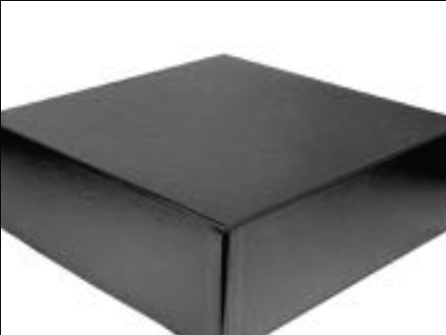
Black Box Testing
We see the program as a black box, we ignore how it is being written

Slide 31
Black Box Testing
If the program is not the code, what it is?
(hint: we know what it is supposed to do)

Slide 32
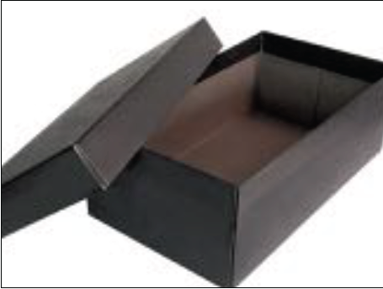
White Box Testing
In White Box testing, tests are written based on the code

Slide 33
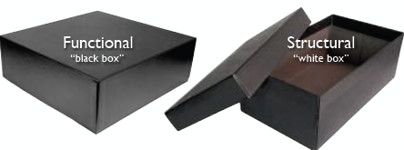
White Box Testing
Black box testing:
Tests based on specification
Test covers as many specification as possible
White box testing:
Tests based on code
Test covers as much implemented behavior
as possible

Slide 34
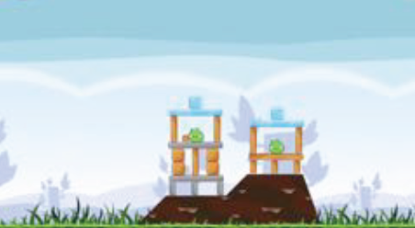
Black Box Testing

Slide 35
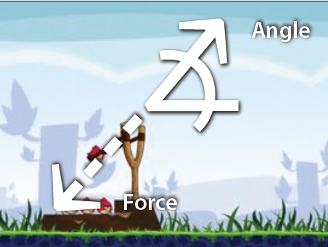
Black Box Testing
Write tests for different Angles and Force (Test Design)

Slide 36
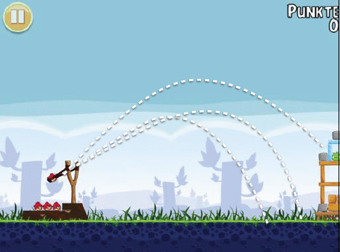
Black Box Testing
Observe behavior and spot potential bugs (Test Evaluate)

Slide 37
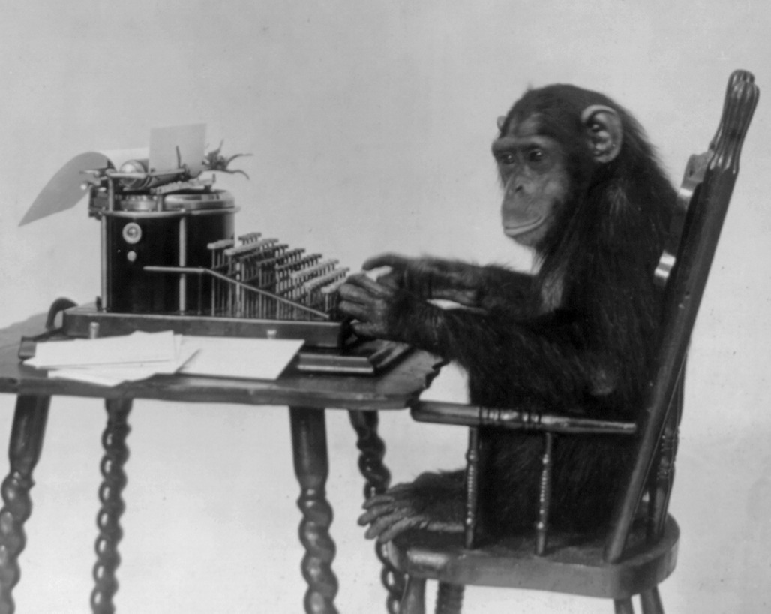
Infinite Monkey Theorem
Picture:
https://en.wikipedia.org
“Monkey hitting keys at random on a typewriter keyboard for an
infinite amount of time will almost surely type the complete works
of William Shakespeare”.

Slide 38

Black Box Testing
Instead of writing novels, let us put a monkey to perform black box tests on Angry Bird

Slide 39
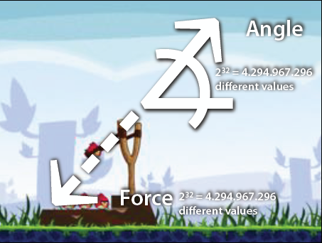
Black Box Testing
Angle -> 2³² possible values
Force -> 2³² possible values
Assuming both Angle and Force are integers

Slide 40
Black Box Testing
Angle -> 2³² possible values
Force -> 2³² possible values
Total possibilities = 2⁶⁴ = 18, 446, 744, 073, 709, 551, 616 diff. executions

Slide 41
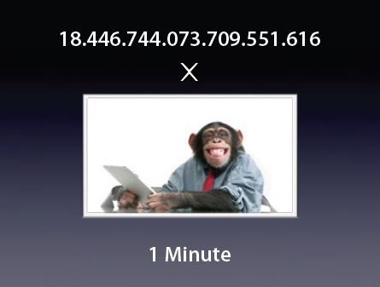
Black Box Testing
Assuming one test takes one minute to execute and evaluate

Slide 42

Black Box Testing
Of course, if you fill the world with 18 million trillion monkeys, we can
test angry bird case in one minute

Slide 43

Black Box Testing
We need a systematic process to design test and evaluate them
(for all testing methodologies)

Slide 44
Exercise 5
Work in pairs. One writes a set of black-box tests for the program implementing the following specification: Given an integer value, the program outputs 0 when the integer value is 0, outputs 1 when the integer value > 0, and outputs -1 when the integer value < 0.
The other implements the programs with the intention to pass the test cases while not satisfying the specification.
Exercise5TestConstructive.java; Exercise5TestDestructive.java

Slide 45
Black Box vs. White Box Testing
Black box testing:
Tests based on specification
Better at finding whether code meets the
specification or some specs are not
implemented
White box testing:
Tests based on code
Better at finding crashes, out-of-bound errors,
file handling errors etc.

Slide 46
Black Box Testing
We see the program as a black box, we ignore how it is being written
Write tests from specification

Slide 47
Specifications
There will be a winner if hit with the right force and right velocity
Specifications should be unambiguous

Slide 48
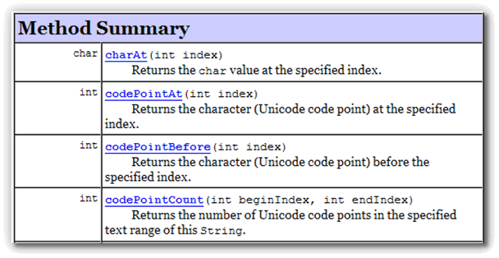
JavaDoc
Specify Java classes and methods
JavaDoc starts out as comments in code

Slide 49
Low-level specification
public class Account {
int balance;
/* @invariant balance >= 0 */
public withDraw(int amount) {….}
}
What kind of test would you design from this documentation?

Slide 50
Low-level specification
/**
* Edit the text in the biodata
* Precondition: isEditMode()
* Postcondition: result != null
* @return
* @param name
*/
public String deliverText(String text) {
…..
}
What kind of test would you design from this documentation?

Slide 51
High-level specification
UI
e.g. tasks user can perform
e.g. click->play->pause->exit
e.g. user interactions in the Angry Bird game
Web server
e.g. URLs
http://sudiptac.bitbucket.io
Whatever://\\$##^^☺/\\
Internet server
e.g. Message format
Header
Payload
Checksum

Slide 52

Exercise 6
Write down 6 test cases for an email client. Write one test for checking successful delivery and five different tests with the intention to make the delivery fail.
Outgoing Server
(e.g. mail.sutd.edu.sg)
Mail Server
(e.g. imap.sutd.edu.sg)
Delivery
(pass or fail)
Email address(es)
(e.g. me@mymail.sutd.edu.sg)
Subject (max. size 1 MB)
(e.g. “Hello World”)
Notes:
TestCase:
Pass (Email: Outgoing Server:Mail:Email)
Fail
Failure (timeout)
Failure (lock out of airplane)
Failure(funny character for invalid email (corruption))
File Size too large
Failure: inadmissible data

Slide 53
Important Consideration for Black Box Test Planning
Look at requirements/problem statement to generate.
Test cases need to be traceable to a requirement.
Repeatable test case so anyone on the team can run the exact test case and get the exact same result/sequence of events.
©L. Williams

Slide 54
Important Consideration for Black Box Test Planning (cont.)
Run the simplest test case first – or you won’t know if the test case failed because basic functionality doesn’t work or if the hard stuff doesn’t work.
Check whether the email client can send (receive) emails to (from) valid email addresses
©L. Williams

Slide 55
Important Consideration for Black Box Test Planning (cont.)
Plan the simplest test to test the failure that you are looking for. If the test case fails, you don’t want to have to work *too* hard to re-run the test when the code is (supposedly) fixed.
http://sudiptac.bitbucket.io
Whatever://sudiptac.bitbucket.io
^^^O://\\$##*&*&^$%^^☺/\\
©L. Williams

Slide 56
Equivalence Class Partitioning
Divide your input conditions into groups (classes).
Input in the same class should behave similarly in the program.
Email address(es)
(valid and invalid)
e.g. su@sutd.edu.sg
e.g. this_is_not/an_email
Delivery
(pass or fail)
Notes:
You havea huge input space for your client. Any kind of stream. You can give any kind of stream in the email addresses. If I only think about the email address stream. Equal partitioning says that you partition the input space with respect to the thing that you expect the software to behave similarly. You expect it to behave similarly for valid and invalid email addresses.

Slide 57
Equivalence partitioning
Sorting
Input Array
Output Array
Sorted array: {0,5,7,89, 111}
Reversed array: {113, 907, 12, 1}
With negatives: {-1, -5, -6, -1111}
With duplicates: {4,6,6,6,6, 121212, 34}
Notes:
You have a sorting algorithm that takes an input array and puts out an output array. Now here, how do you want to partition? Input space is all possible sequence of integers. How do you partition the input space in this case. What are the different class of inputs where you expect the output to behave similarly. How do you partition the input where in each partition, you expect the sorting to behave similarly.
All positive numbers: that’s one. When you create a partition, you need to reason why it needs to be different. Should be one element? So that it should not crash. You do not want to differentiate based on the individual value of the elements. What kind of features you want to test.

Slide 58
Equivalence partitioning
Reverse a
list
Input list
Output list
Input list: {0,1,7,89, 111}; Output List = {111, 89, 7, 1, 0}
How do you design the partitions?
Notes:
Here, I have a list, don’t know how it is implemented. Input and output are lists, print in the opposite order. What kind of partitioning you want to design.

Slide 59
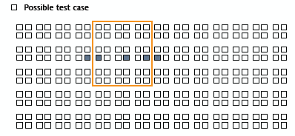
Boundary value analysis
Partition
Boundary value
Middle in the range
Boundary value

Slide 60
Boundary value analysis
(valid email)
su@sutd.edu.sg
(middle value)
blahZblahblahblah@sutd.edu.sg
(max length email, boundary)
Email address(es)
(valid and invalid)
(Invalid email)
$$6**@I.do.not.know
(middle value)
su@@sutd.edu.sg
(only one extra @, boundary)
Delivery
(pass or fail)
Notes:
Remember here, only one input, email address. Partition between valid and invalid because client will behave similarly for invalid and valid. Now have two partitions. What do I mean by boundary and middle values. Middle value: su@sutd.edu.sg because more like a traditional email ID. Most of the client will have limitation on length of email ID. So reach maximum length? So pushing the boundaries. If have some maximum length. Want to have one test for the maximum length. Check if it still works properly. Middle value is more like a common case, boundary value like the max case.
Invalid emails are common. Uncommon cases here has two @ here. But close to valid email. It’s a corner case. I have two @ here. This is called the boundary value and the middle value. So first thing, if you manage to partition the input space. Then the next step is to find the boundary value and the middle value for each of the partitions. One of the partitions has only one element because cannot have multiple MPVs. It is possible for many other partitions, you have multiple values inside one partition. Here, invalid email is where you can put a random stream of characters.
Take one which is pretty close. My intention is that if I give this email id, then it will give the email id. Try to see if the client is able to deliver the email. I am very close to the corner, I have the maximum length, but I want the client to deliver the email. Can see if got common values near the partition. It is common to test for someone’s code.

Slide 61
Dirty/Failure Test Cases
Can something cause division by zero?
What if the input type is wrong
Expected Integer, Test = 2.345
What if the customer takes an illogical path through your functionality?
Enter invalid email address or URL
What if mandatory fields are not entered?
Do not enter recipient’s email to send email
What if the program is aborted abruptly or input or output devices are unplugged?
Quit a game suddenly in the middle, does it save the state?
Notes:
You want to use it in an unintended way, and check if the software crash or not. Similarly, this is another way of using the software. Enter some invalid email. Then another thing is when you are sending another email you are not filling up another form. Third is properly the most abrupt. Dramatic thing; quit the software and check what happens.

Slide 62
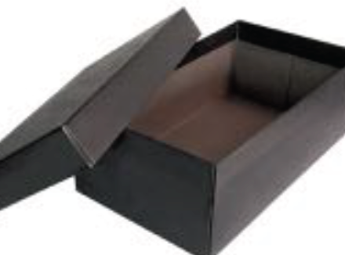
White Box Testing
We see the program as code, we test as many implemented
features as possible

Slide 63
Coverage
Make sure tests cover each part of program
Every method
Every statement
Every branch
Every path
Every condition
Every loop
Measures the quality of tests
Notes:
Not five tests for each of the method, but tests to cover each of the method.

Slide 64
Every Method
For each method, there must be one test case which executes it.
BiSectionExample.java; BiSectionTest.java

Slide 65
Every Loop
For every loop, there is a test case which executes the loop zero time, 1 time, etc., if feasible.
BiSectionExample.java; BiSectionTest.java

Slide 66
Control Flow Graph
For advanced white-box testing, it is often important to capture the control flow of the program
For this, we have control flow graph (CFG)

Slide 67
Control Flow Graph
cond1
while (cond1) {
if (cond2)
//stmt1
else
//stmt2
}
//stmt3
cond2
stmt1
stmt2
Loop Tail
stmt3

Slide 68
Control Flow Graph
d >= e
System.out.
throw …
e–d >= f
middle < e
BiSectionExample.root()
Loop Tail
error
System.out…
return

Slide 69
Exercise 7
Open Disk.java. Draw the control flow graph of the function manipulate().
Disk.java

Slide 70
Every Statement
For each statement, there must be one test case which executes it, if feasible.

Slide 71
Exercise 8
Write a set of tests to cover each statement of the manipulate() function. How many tests did you write? Is it the minimum number of tests to cover all the statements?
DiskStatementCoverage.java

Slide 72
Every Branch
For each branch, there must be a test case which executes it.

Slide 73

Every Branch
d >= e
BiSectionExample.root()
throw …
System.out.
e–d >= f
A test where d >= e
A test where d < e
middle < e
A test where e-d >= f
A test where e-d < f
A test where middle < e
A test where middle >= e
Loop Tail
Note: A single test may cover multiple branches
error
System.out…
return

Slide 74
Exercise 9
Write a set of tests to cover each branch of the manipulate() function. How many tests did you write? Is it the minimum number of tests to cover all the branches?
Disk.java; DiskBranchCoverage.java

Slide 75
Every Path
A path is defined as a sequence of node in the control flow graph between the entry node of the graph and the exit node
cond1
cond2
cond1->cond2->stmt1->loop tail->stmt3 is a path
cond1->cond2->stmt1->loop tail->cond1->cond2
->stmt2->loop tail->stmt3 is also a path
stmt1
stmt2
cond1->cond2->stmt1->stmt2->loop tail->stmt3
is not a path
Loop Tail
How many paths in total?
stmt3

Slide 76
Every Path
x > 100
yes
no
x >= 200
yes
no
Remember some paths may be infeasible
stmt1
stmt2
How many paths in total?
Loop Tail
stmt3
Infeasible

Slide 77
Exercise 10
How many paths are there in the manipulate() function? Explain your answer.
Disk.java

Slide 78
Every Condition
For each condition, there must be one test case which satisfies it and one which dissatisfies it.
Question: how many test cases we need?
if (A && B) …
if ((j>=0) && salary[j] > 10000) ...

Slide 79
Exercise 11
Consider your test cases that obtain branch coverage in the manipulate() function. Argue whether the test suite also obtains the condition coverage.
Disk.java; DiskBranchCoverage.java

Slide 80
White-box tests
Purpose: exercise all the code
Large number - take a long time to write
Good for finding run-time errors
Null object, array-bounds error
In practice, coverage can be better for evaluating tests than for creating them

Slide 81
Devising a Prudent Set of Test Cases
Equivalence Class/Boundary Value Analysis
Still applies!
A metric for assessing how good your test suite is.
Method Coverage
Statement Coverage
Decision/Branch Coverage
Condition Coverage
©L. Williams

Slide 82
Techniques for writing tests
Black-box (from specifications)
Equivalence partitioning
Boundary value analysis
White-box (from code)
Example: Branch coverage
Fault-based testing (from common errors)
Think diabolically

Slide 83
Fault-based Testing
float foo (int a, b, c, d, e) {
if (a == 0) {
return 0.0;
}
int x = 0;
if ((a==b) OR ((c==d) AND bug(a) )) {
x +=1;
}
e = 1/x;
return e;
}
What test cases would you like to create?

Slide 84
Exercise 12
Consider Disk.java. Assume that specification requires all the functions in the Disk class to be non-terminating. Write a Junit test that potentially reveals a bug in the manipulate() function.
DiskFaultTest.java

Slide 85
Exercise 13
Given method multiply Russian.java,
Create a test suite for black-box testing.
Create a test suite for white-box testing
With 100% branch coverage
Create a test suite for fault-based testing
Russian.java; RussianTest.java

